Slide 1

Image-Based Plant Disease Detection
Engineering Project in Community Service
Progress Review II

Slide 2
Details of Previous Review
Model training
Model testing
Model Validation

Slide 3
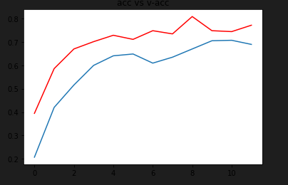
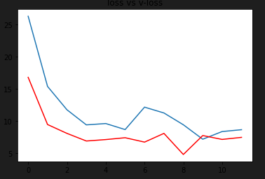
Training Data – Accuracy
As seen from the two mapped figures representing loss and accuracy we can see that :
Loss is declining gradually
Accuracy is increasing
This shows that the model is working and learning properly.

Slide 4
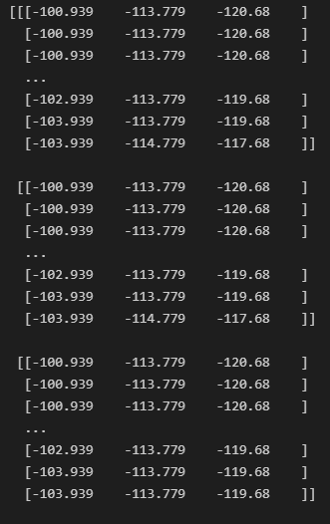
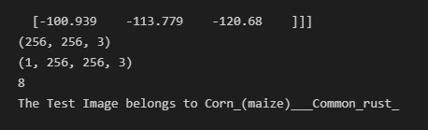
Testing Data - Sample Result
Test Image Mapping
Output for test image.

Slide 5
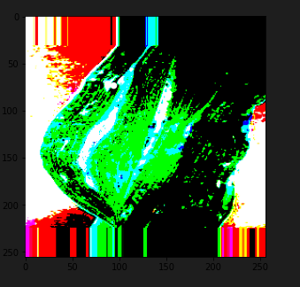
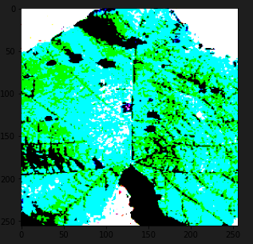
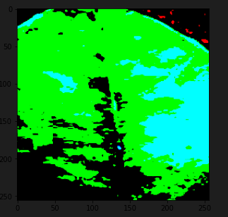
Implementation and Results
Clipping input image data to map true color RGB image.

Slide 6
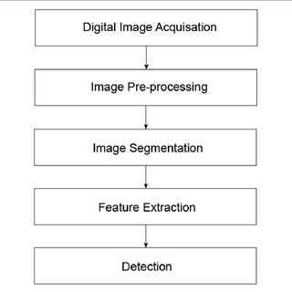
Steps for Disease Detection
1.Image Acquisition
2.Image Segmentation
3.Feature Extraction
4.Classification

Slide 7
Progress thus far
Designed a website to integrate our model.
Why ?
To enable users to use our service to assist them in various plant disease detection.
Talking Points
Aim
Steps to integrate
Persist the model
Create a useful interface using Flask
Host the service using Heroku cloud server

Slide 8
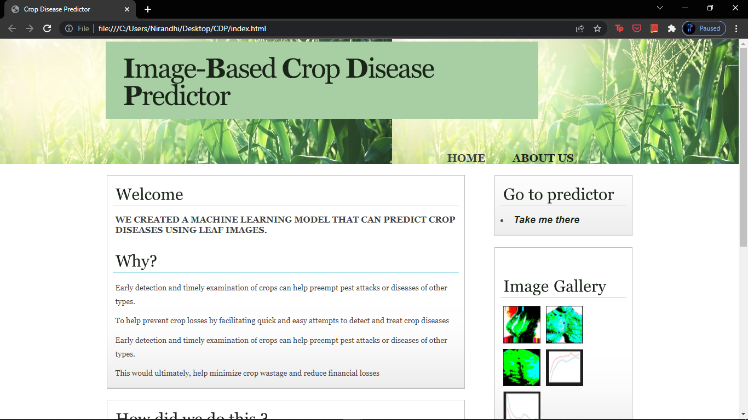

Slide 9
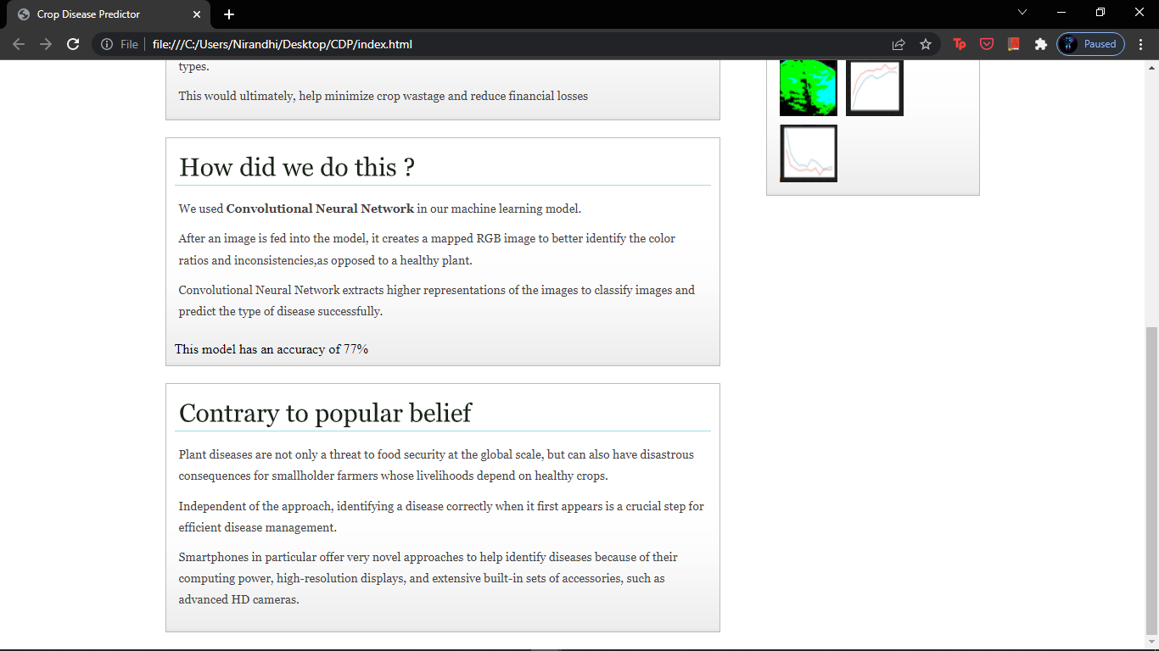

Slide 10
Next Phase Plans
Accuracy enhancement
Deploying the model
Creating an interactive interface
Web server hosting
Disease Treatment Knowledge and Tips for prevention (on website)
Knowledge creation and awareness

Slide 11
Thank You

